Slide 1
Outline
Pollination is important
we think as a positive relationship
But in reality is a balance between positive and negative
Therefore We want to understand the competition
There trade off between the number of partners and the benefit
But we don’t know if that a thing? And how it relates to quantity and quality
Therefore we do that here
But its not possible because you need lots of data
We collect four aspects of pollination at community level
We bootstrap set of models
Construct quantity and quality
It’s a thing but not a biggie

Slide 2
the pollination
trade-off
Annual Biology Conference 2018
Fernando Cagua
Hugo Marrero
Jason Tylianakis
Daniel Stouffer

Slide 3
the pollination
is
mutualism
but also
competition

Slide 4
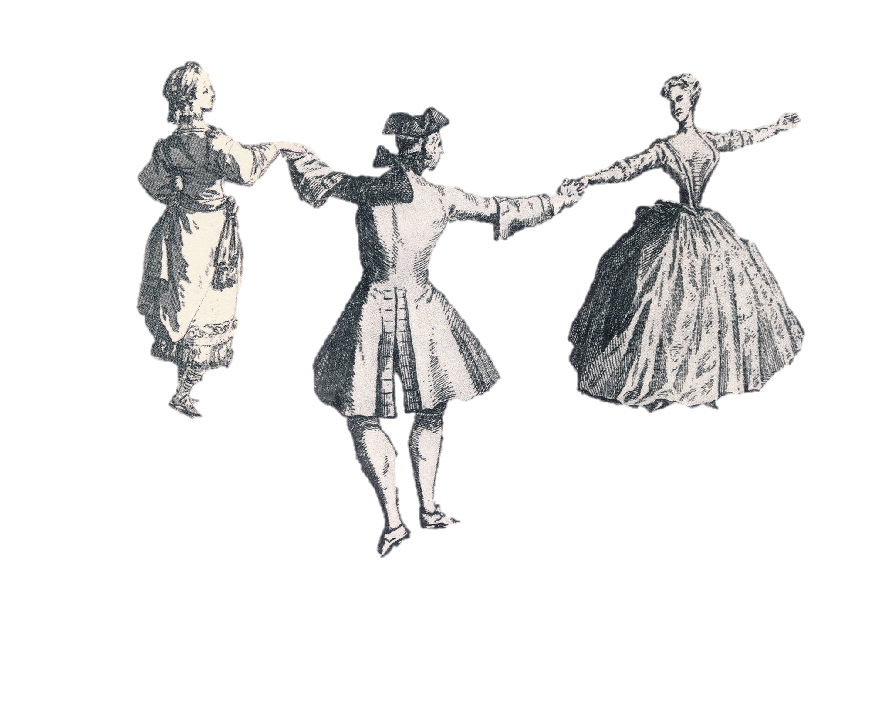
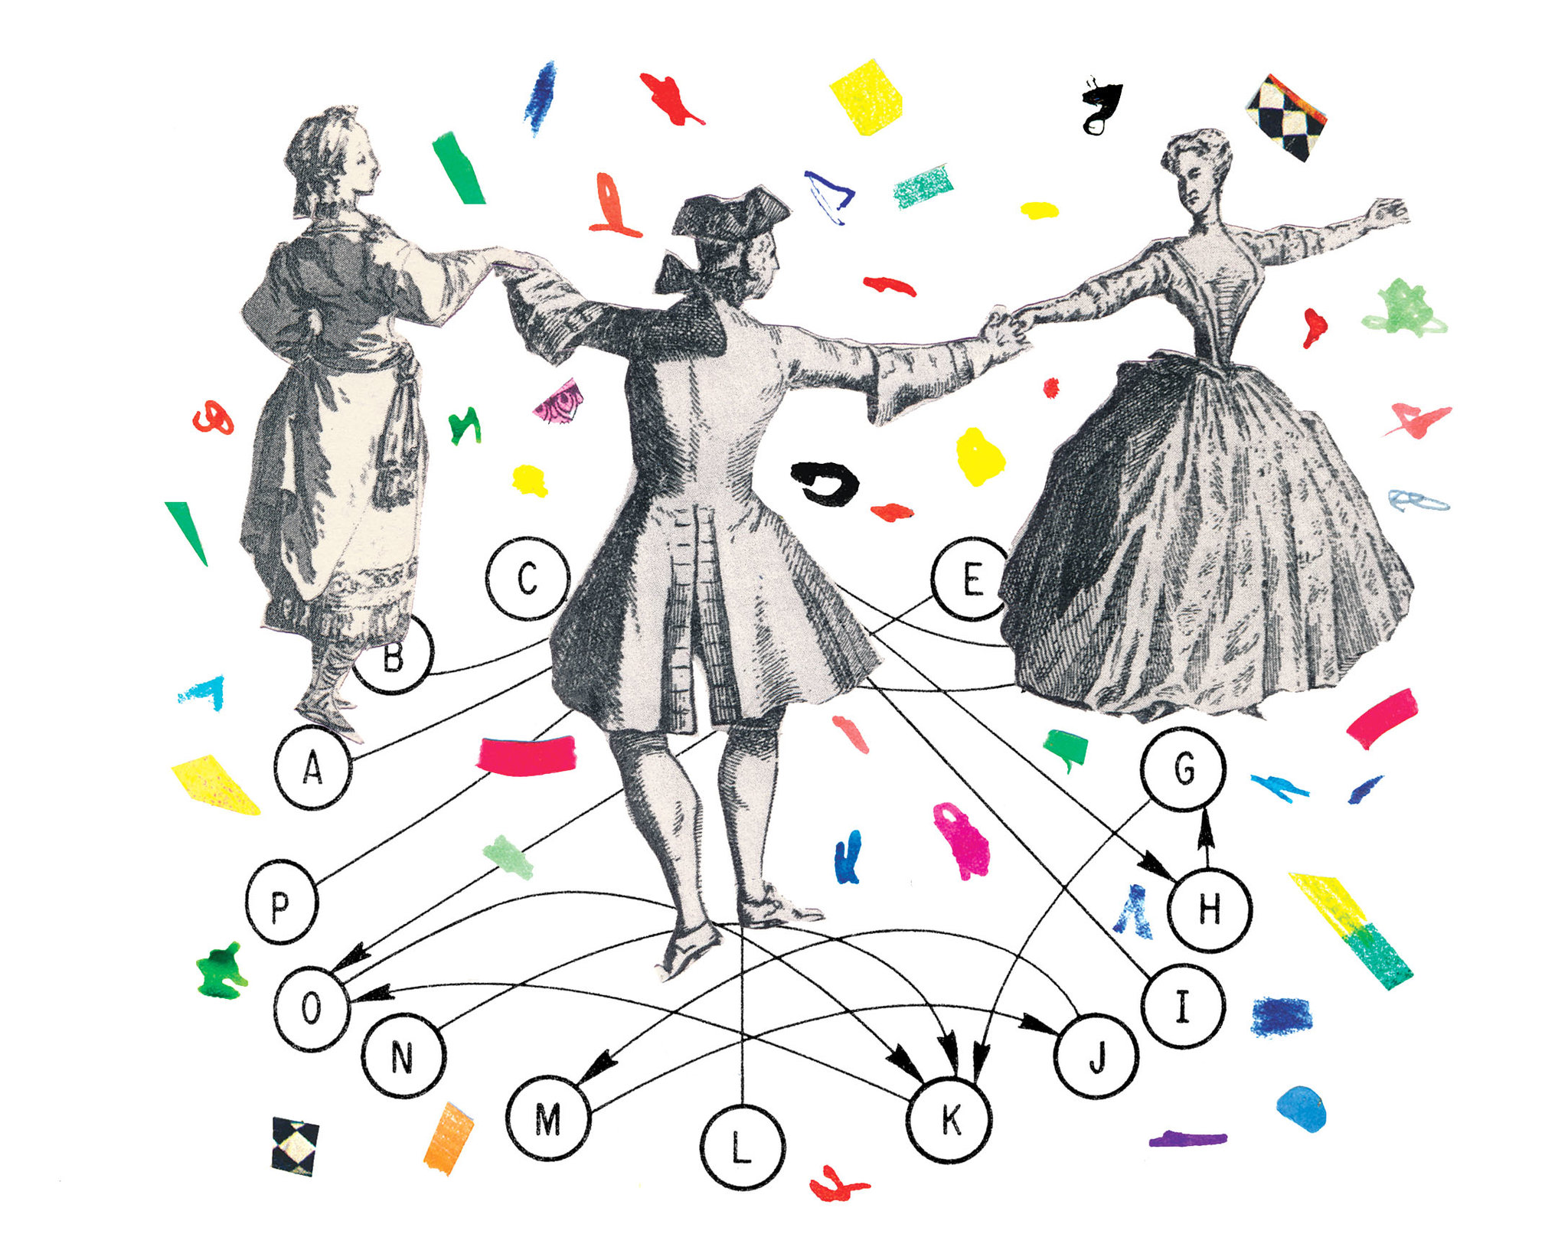
trade-off?
number of interactions vs. pollination service
is there a
in a community ?
Illustration: Joanna Neborsky – The New York Times

Slide 5
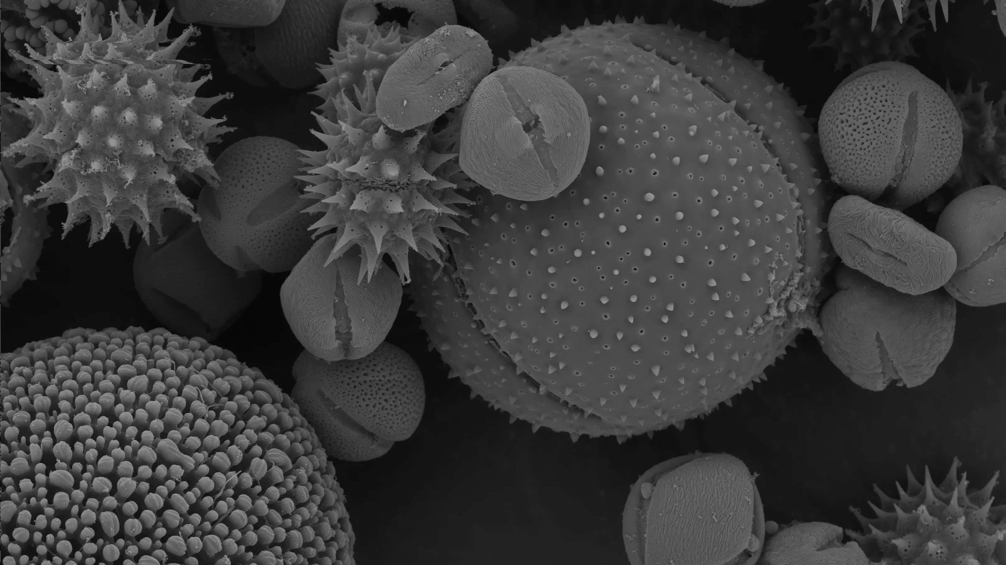
we need to measure the
we measure the
quantity & quality of the
pollination service
Photo: Dartmouth Electron Microscope Facility

Slide 6
we measure the
conspecific &
heterospecific
pollen on stigmas
Photo: Dartmouth Electron Microscope Facility
Photo: Martin Oeggerli – National Geographic

Slide 7
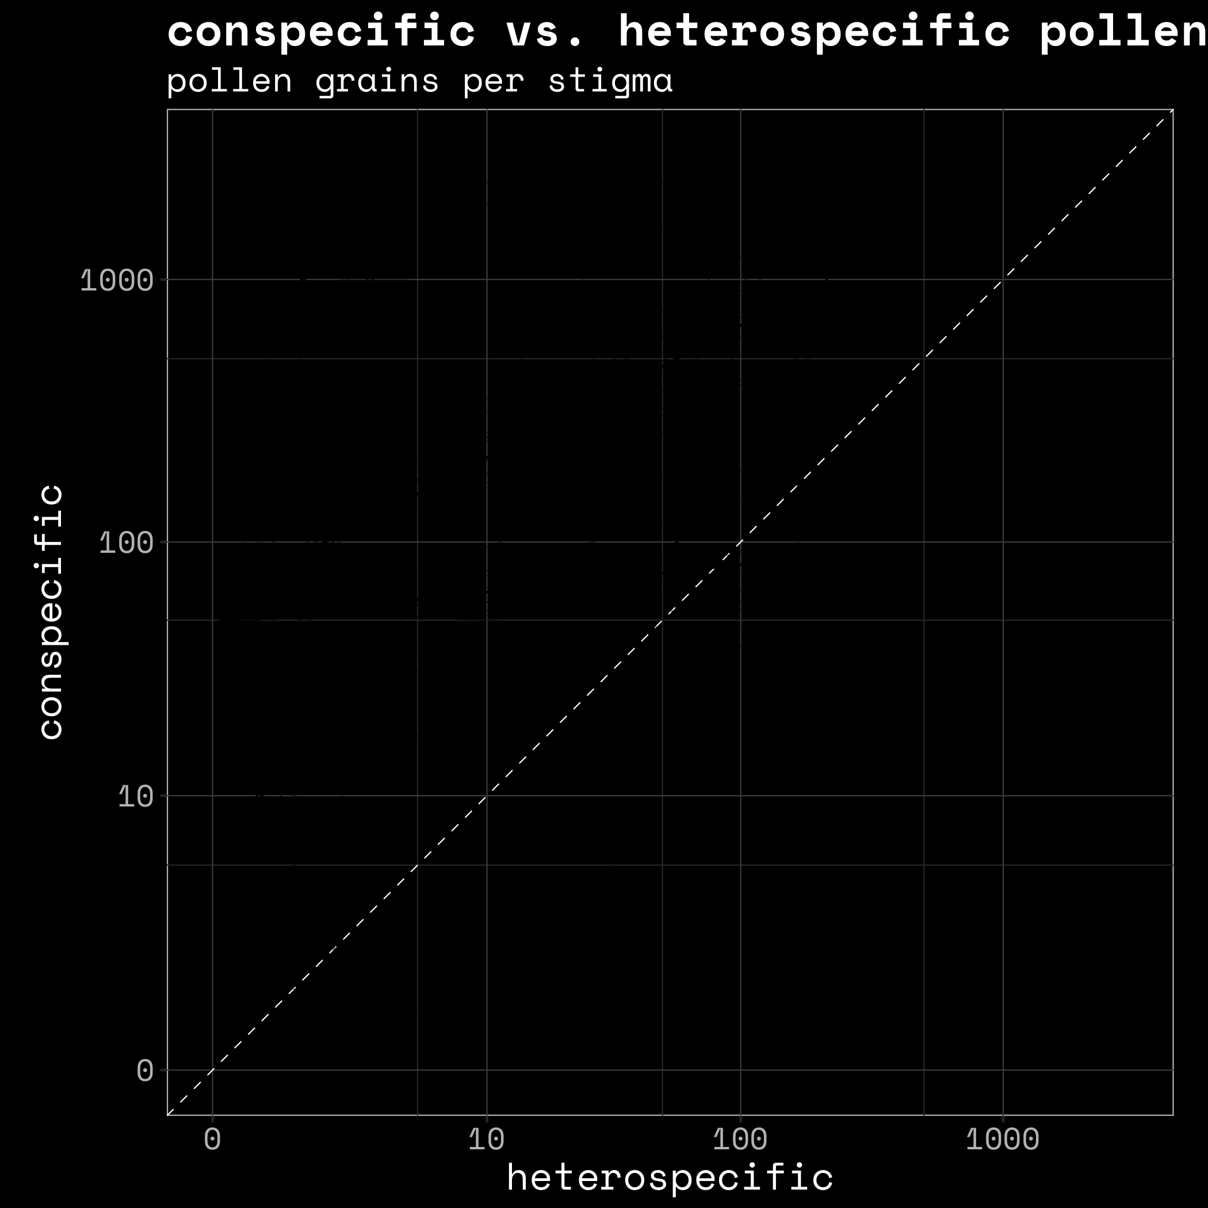

Slide 8
12 communities
- pollen on stigmas
Martin Oeggerli – National Geographic
Notes:
In each transect we counted the pollen in the stigmas and looked at wether the pollen was conspecific or heterospecific

Slide 9
interspecific
pollen
transfer
Photo: Dartmouth Electron Microscope Facility

Slide 10
conspecific
vs.
heterospecific
Photo: Dartmouth Electron Microscope Facility

Slide 11
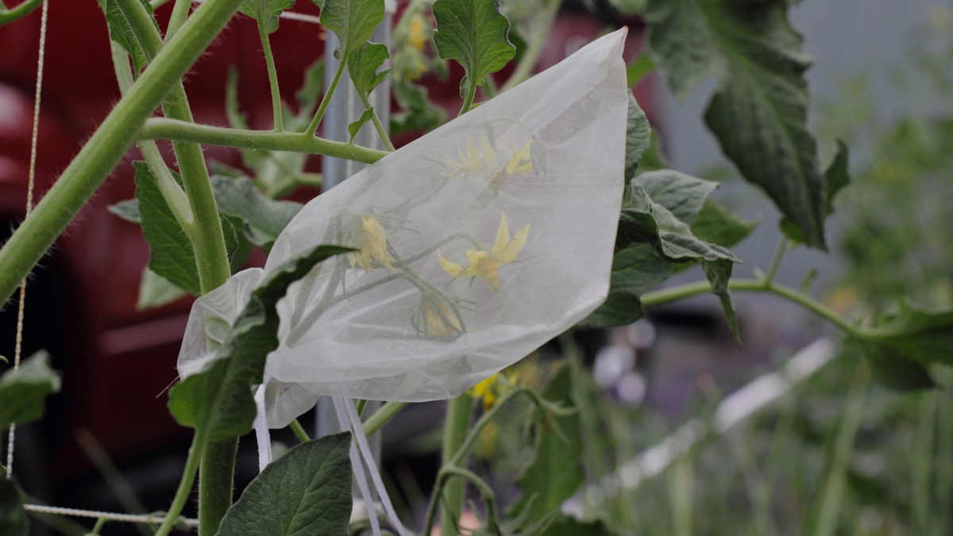
2
ways to view the pollen
deposited on the flower
absolute amount
absolute amount (open)
relative amount (open - bagged)
Helena Jole

Slide 12
12 communities
- pollen on stigmas
- pollen on animals

Slide 13
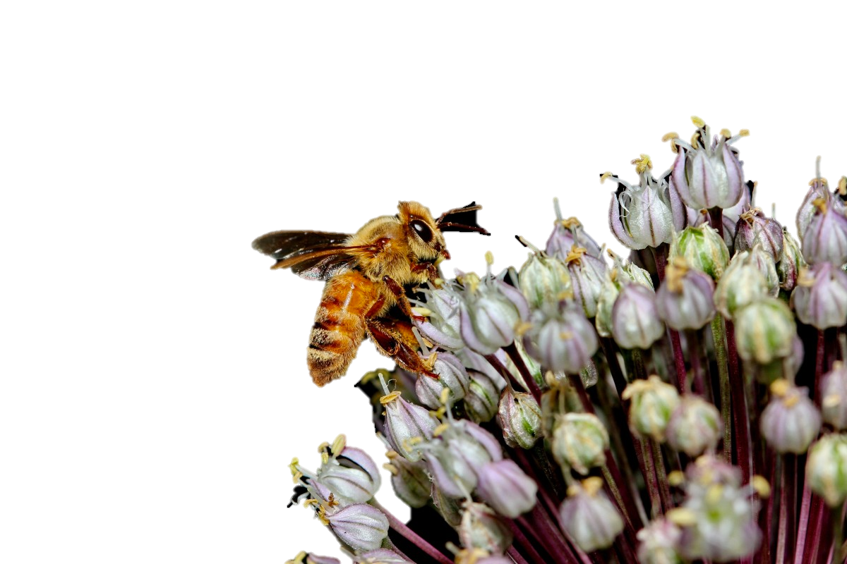
12 communities
- pollen on stigmas
- pollen on animals
- visitation
- abundance
Notes:
It is a very rich dataset and this project started, remember the focus of this presentation is the relationship between the number of partners and the interspecific pollen trasnfer. I’m going to focus on the stigmatic pollen and the visitation. So remember the

Slide 14
3 response variables
- heterospecific pollen
- conspecific pollen (absolute)
- conspecific pollen (relative)
Helena Jole

Slide 15
4 explanatory variables
- degree
→ to evaluate the trade-off

Slide 16
4 explanatory variables
- degree
- abundance
→ density effects
- share in pollen pool

Slide 17
4 explanatory variables
- degree
- abundance
- share in pollen pool
traits → phenology
phylogeny
- functional originality

Slide 18
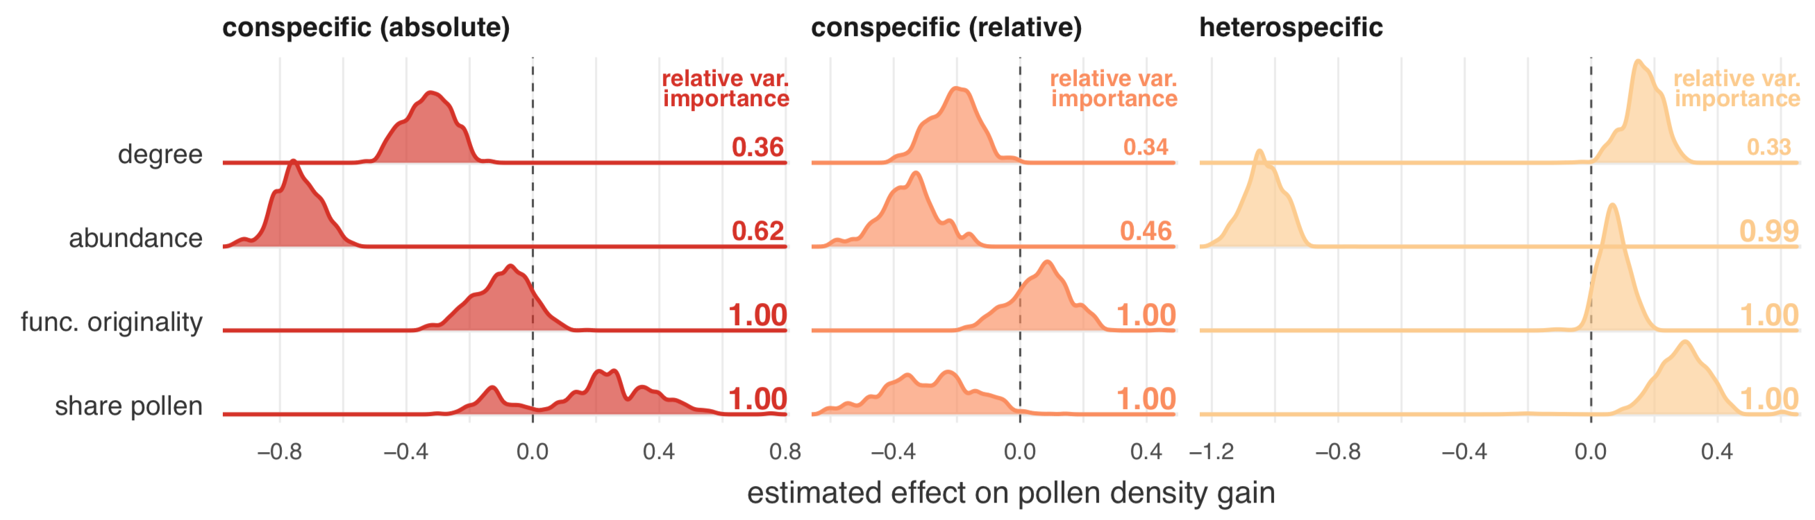

Slide 19
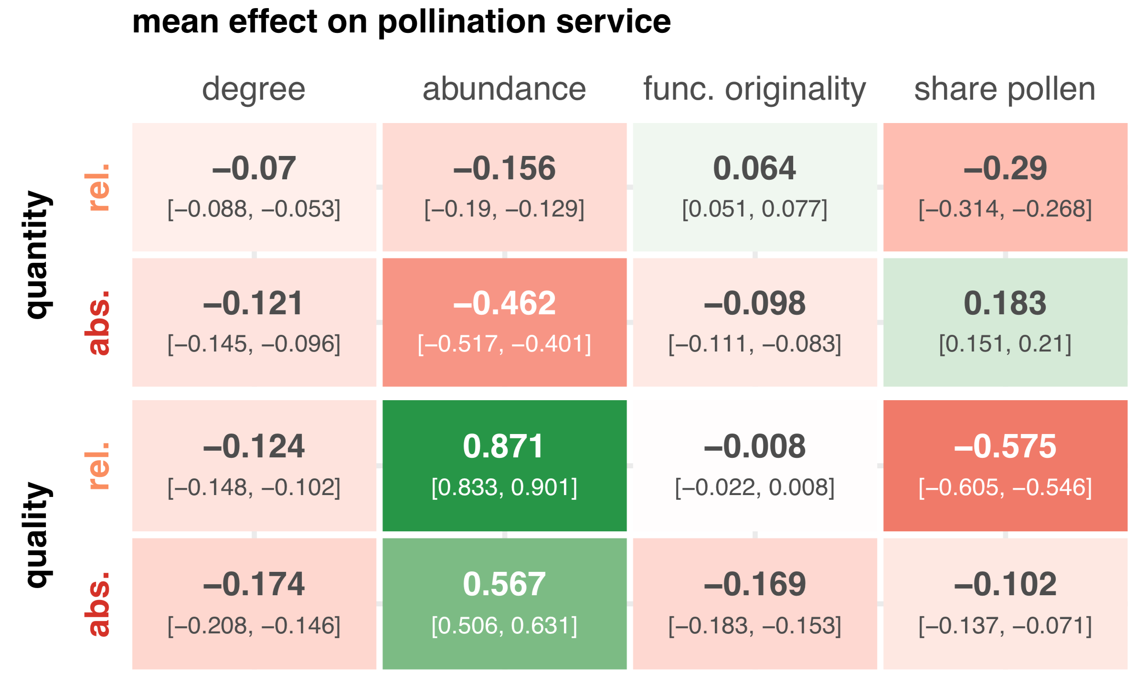

Slide 20
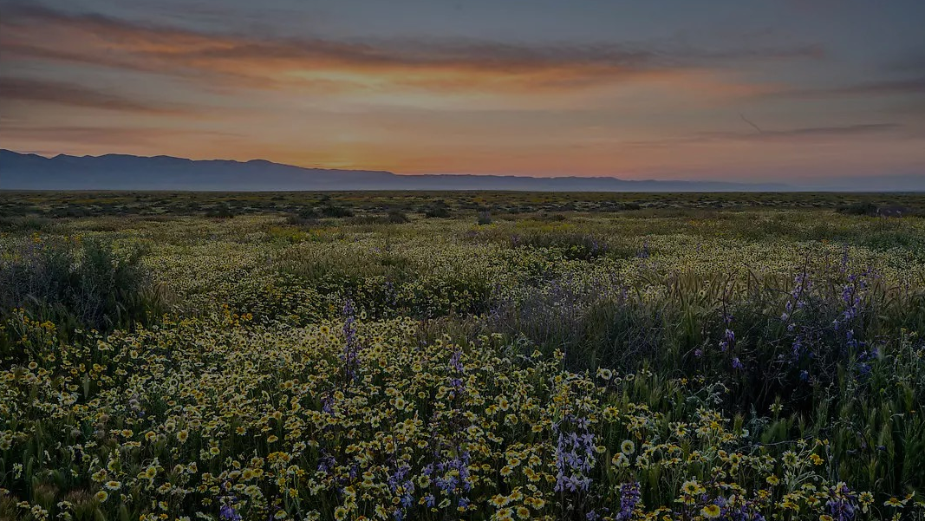
small trade-off
perhaps plants are using mechanisms to overcome it
Notes:
body parts, abundance, dependency on animal pollination

